Slide 1

Financial Analysis of an Engineer
Team 8:
•Simran Bhatia
•Saksham Saxena
•Sachin Gahane
•Kaustubh Khedekar
•Rehan Ahmed
•Rahul Kotikalpudi

Slide 2

Objective
Many graduates struggle with managing their finances effectively.
Wise financial decisions have a long-lasting impact on quality of life, including retirement.
This study aims to analyze the expenses of a 23-year-old at the start of their financial journey.
Principles learned in Economic Decision-Making class were applied to develop an expense schedule and forecast personal finances at retirement.

Slide 3

Persona
Age: 23 years
Education : Bachelor's in computer science
Location : USA

Slide 4

Description
Factors include cost of living, transportation, and location up to retirement age, along with three different stock investment options
A total of 12 alternatives are offered, which consist of various combinations of city location-investment types - education level.

Slide 5



Scenarios
City: Boston (Massachusetts) vs Los Angeles (California)
Education: Bachelor's in computer science vs Bachelor's + Master's in computer science
Stock investment: No investment vs Low Return on investment vs High Return on investment

Slide 6

Alternatives
The analysis conducted by the team focused on Bachelor's and Master's degree programs, taking variables such as cost of living, transportation expenses, and location up to retirement age.
The team researched several cities, with a focus on Boston and Los Angeles, both of which are prominent IT hubs but have varying living costs.
A shortlist of 12 alternatives was created by the team, consisting of a degree program, a city to consider, and an investment option among no stock investments, low-risk returns, and high-risk returns.
The purpose of creating these alternatives was to weigh them against each other to determine the optimal approach for achieving educational and financial objectives.
By considering these factors, the team aimed to help individuals make informed decisions about their education and financial future.

Slide 7

Baseline Decision Criteria
Salary
Signing bonus
Loan (Bachelor’s, Master’s, Car and House)
Transportation (Use of Public Transport, Uber, Lyft, First Car, Second Car)
Accommodation (Rent, House)
Stock investments (No Stock, Low Return Stocks, High Return Stocks)
Retirement fund Contribution with Employers Match
Retirement fund receipt
Increase in salary rate
Insurances (Car, House and Medical)
Taxes (State and Federal)
Food + Leisure Expense

Slide 8

Education loan
Interest rates for bachelor's and master's loans are influenced by a range of factors, including state regulations, academic institution partnerships, and individual financial circumstances.
Scholarships and other benefits can impact the interest rates for these loans, so it's important to consider these factors when choosing a loan option.
The average interest rate for bachelor's and master's loans is currently 4.45%, but this rate can vary depending on the lender, loan type, and borrower's credit score.
To find the best interest rate and terms for their unique financial situation, it's crucial for borrowers to research and compare different loan options thoroughly.

Slide 9

Education Loan: Assumptions
 | Boston | Los Angeles
Bachelor’s Loan | $ 125000 | $ 150,000
Master’s Loan | $ 60000 | $ 75000
Loan Interest | 4.45% | 4.45%
No. of periods (Months) | 180 | 180

Slide 10

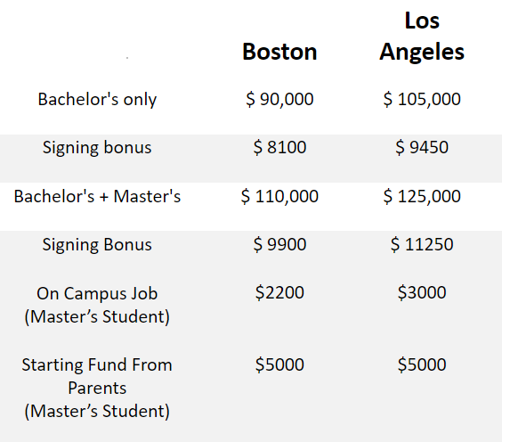

Salary
Alternatives

Slide 11


State + Federal Tax Rates
Boston
29.1%
Los Angeles
32.5%

Slide 12

Retirement Fund Contribution
Retirement Fund Contribution | 3% of Salary every month
Employer’s Match | 3% of Salary every month
Retirement Fund Receipt | 8% of the total contribution

Slide 13

Transportation
 | Boston | Los Angeles
Transport (Student) | $ 200 | $ 250
Transport | $ 400 | $ 500
Increment (Monthly) | 3 | 3

Slide 14

First Car
 | Boston | Los Angeles
Cost of car | $30000 | $40000
Down Payment | $5000 | $6000
No. for Period (months) | 60 | 60
interest for car loan | 5% | 5%
Monthly Payments | $471.78 | $641.62
Resale (After 15 years) | $3000 | $4500
O&M Cost | $66 | $80
Increment | 1 | 1

Slide 15
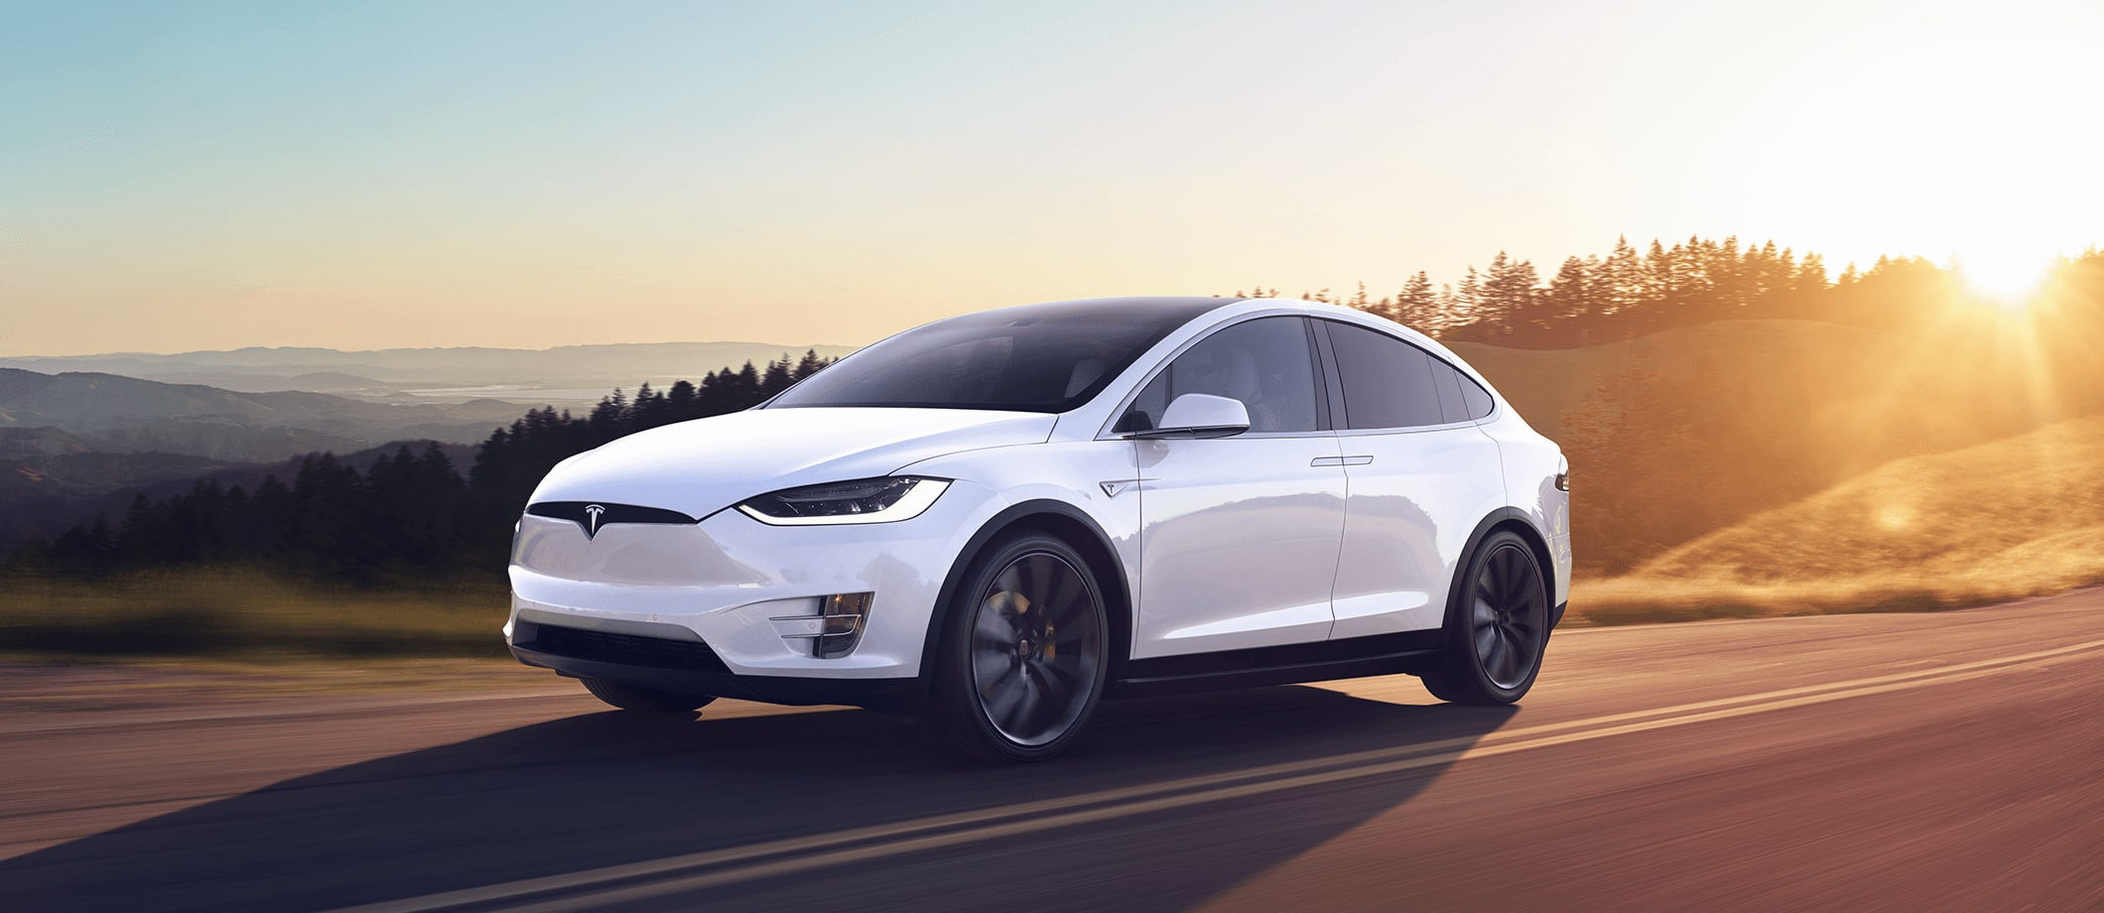
Second Car
 | Boston | Los Angeles
Cost of car | $70000 | $90000
Down Payment | $10000 | $12000
No. for Period (months) | 60 | 60
interest for car loan | 5% | 5%
Monthly Payments | $1132.27 | $1471.96
Resale (After 15 years) | $5000 | $7500
O&M Cost | $100 | $125
Increment | 1.5 | 1.5

Slide 16

Rent
 | Boston | Los Angeles
Rent | $1500 | $2000
Increment (Yearly) | 6.1% | 6.1%

Slide 17

House
 | Boston | Los Angeles
Cost | $800,000 | $1,000,000
Down Payment | $50000 | $60000
House Loan Interest | 4% | 4%
No. of Period (monthly) | 360 | 360
Monthly Payment | $3580.61 | $4487.70
House Resale Value (6% Appreciation) | $4,594,792.94 | $5,743,491.17

Slide 18

Food and Leisure Expense
 | Boston | Los Angeles
Expense (Monthly) | $500 | $600
Increment (Monthly) | $5 | $5

Slide 19
Insurances
 |  | Boston | Los Angeles
Car Insurance (Monthly) | First Car Payment | $200 | $250
 | Second Car Payment | $300 | $400
Medical Insurance (Monthly) | Payment | $150 | $200
 | Increment | 3.5% | 3.5%
House Insurance (Monthly) |  | $125 | $175

Slide 20

Stocks
Investing in stocks involves purchasing and retaining ownership of a company's shares with the objective of earning a profit in the long run.
This grants the investor shareholder status, entitling them to a portion of the company's profits through dividends, while the value of their shares can increase or decrease depending on the company's performance and prevailing market conditions.
High Stocks Returns
Low Stocks Returns
No stocks

Slide 21
Stocks
Investment in Stocks (Monthly) | 4% of Salary every month
High Return of Stocks | 12% per annum nominal
Low Return of Stocks | 6% per annum nominal

Slide 22

Alternatives for Boston, MA
Bachelor’s not investing in stocks.
Bachelor’s investing in stocks with low return.
Bachelor’s investing in stocks with high return.
Bachelor’s + Master’s not investing in stocks.
Bachelor’s + Master’s investing in stocks with low return.
Bachelor’s + Master’s investing in stocks with high return.

Slide 23
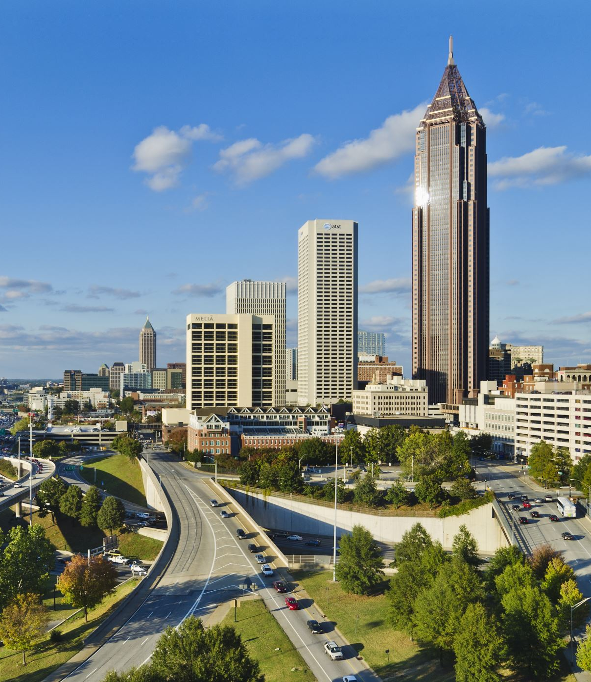
Alternatives for Los Angeles, CA
Bachelor’s not investing in stocks.
Bachelor’s investing in stocks with low return.
Bachelor’s investing in stocks with high return.
Bachelor’s + master’s not investing in stocks.
Bachelor’s + master’s investing in stocks with low return.
Bachelor’s + master’s investing in stocks with high return.

Slide 24
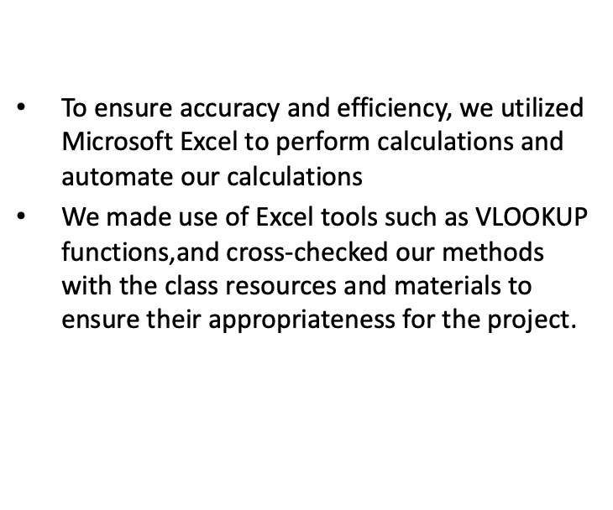
The tools of engineering economy are utilized for

Slide 25
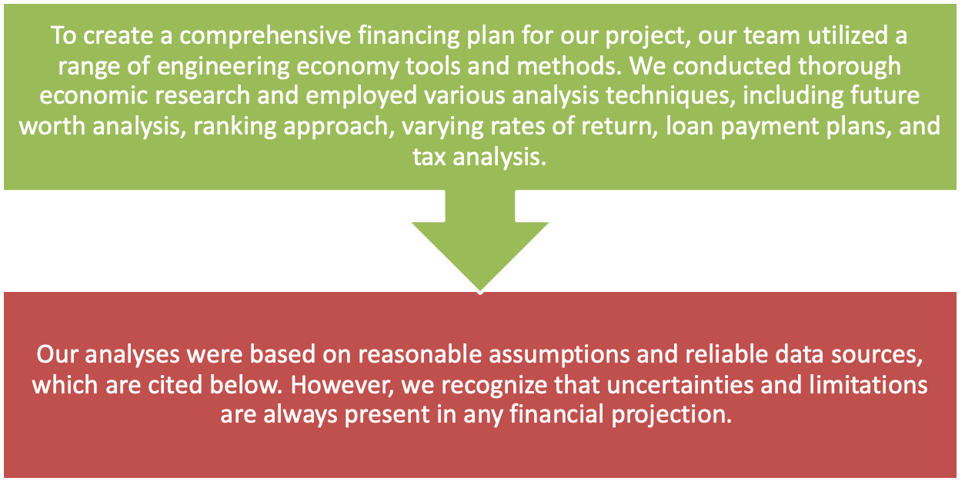
Use of Engineering Economy

Slide 26
FW vs MARR (1% to 6%)

Slide 27
FW vs MARR (7% to 12%)

Slide 28
Difference in Low Return of Stocks and No Stocks
Total savings
Total savings
Boston(MA)
Los Angeles(CA)

Slide 29
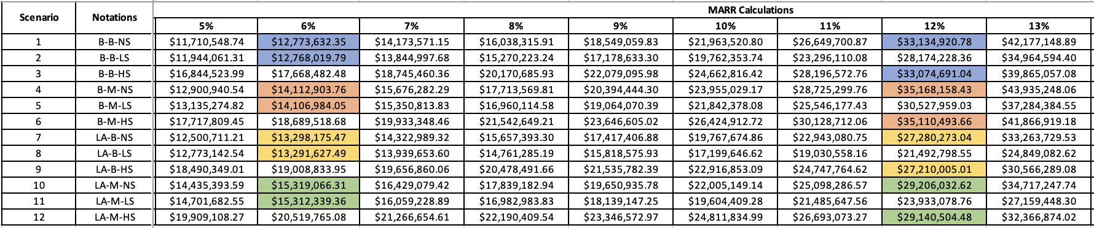
Stock return comparison

Slide 30
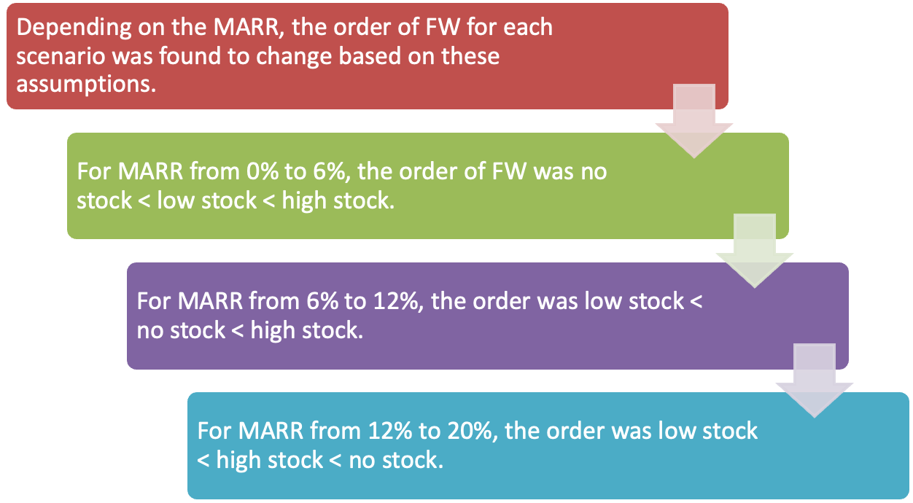

Results
Notes:
rehan

Slide 31
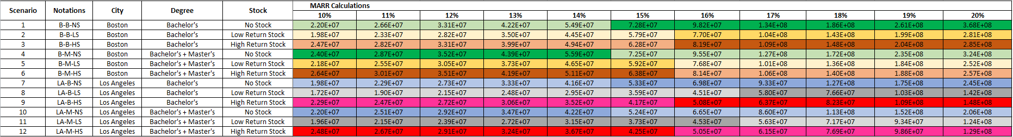
Bachelor's vs Master's comparison

Slide 32
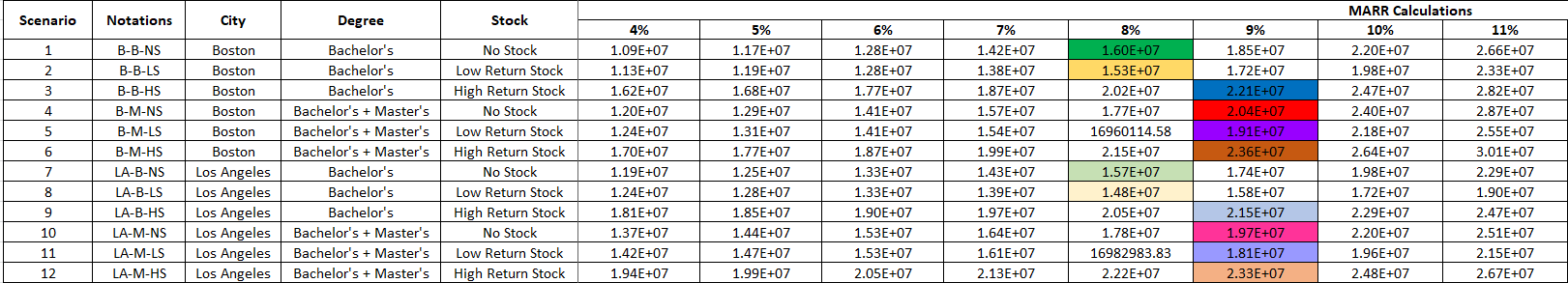
Boston vs LA city comparison

Slide 33
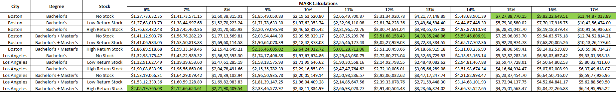
Best case scenario

Slide 34
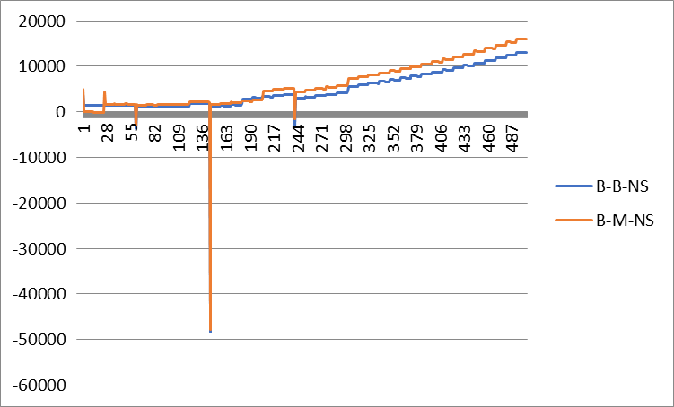
B-B-NS VS B-M-NS
Total savings in bank

Slide 35
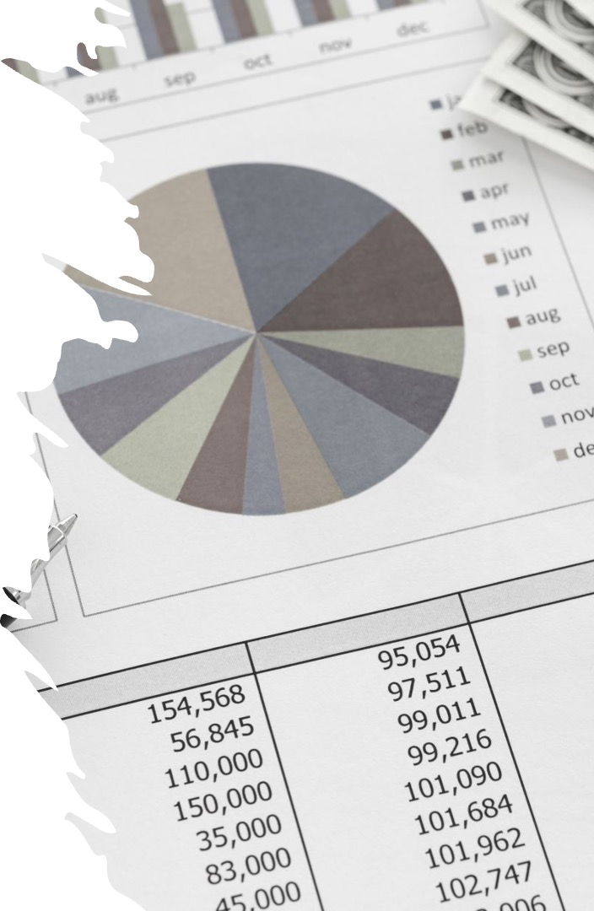
Summary
From the comparison of 12 different scenarios, we see that future worth varies based on MARR, it is different for different scenarios.
Living in Los Angeles, pursuing masters is preferred for lower rates of MARR, and it tends towards Living in Boston, and pursuing only Bachelor's.
Notes:
rehan

Slide 36

Recommendations
Up until 8% MARR, living in LA and investing in high yield stocks is best option.
Beyond 8%, until 14%, living in Boston and pursuing masters is best option, stock investment recommendation switches at 12% as expected.
From 15% onwards, living in Boston, not investing in stocks and pursuing only Bachelor's is the best option.
Notes:
rehan

Slide 37

Conclusion
In order to maximize future worth, it is important to analyze one's finances using as many factors as possible, the results are not always expected and only through analysis, we can understand the nuance.
Notes:
rehan

